Slide 1
ODIN 2.0
Winter/Spring 2020
ABRAM FOUTS TODD TOWNSEND KARLA BARRAZA LOPEZ XUENING JIA WENHAO CHENG

Slide 2
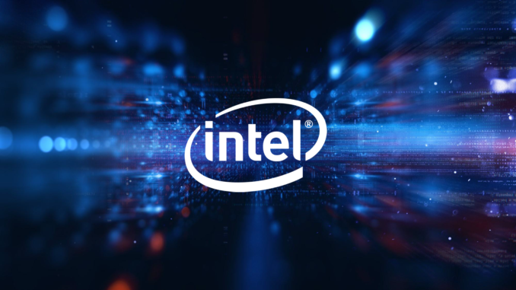
PROJECT SPONSOR
INTEL CORPORATION

Slide 3
Problem
Ocular Divergence:
Strabismus: Abnormal alignment of the eyes(mild to severe below)
Amblyopia (Lazy Eye)
Diplopia (Double Vision)
Oculomotor Palsy (The eye will be displaced in different ways---Unsteady)
Oculomotor Paralysis (The eye will be displaced in different ways-----Fixed)
Other conditions (physical abnormalities, nerve damage, muscle damage)

Slide 4
PROJECT PURPOSE
Correction of Strabismus
Strabismus is more commonly known as cross-eyed or wall-eyed, is a vision condition in which a person can not align both eyes simultaneously under normal conditions. One or both of the eyes may turn in, out, up or down.

Slide 5
REQUIREMENTS
Must:
Establish/Build Host Environment
Software Migration FOVE to HTC Vive Pro Eye
Integrate Gaze Vectors into Correction Vectors
Integrate touch controller
Host the program within SteamVR
Should:
Adjust the view plane per individual eye to match the current gaze vector
Correction to Cure of strabismus through the use of VR

Slide 6
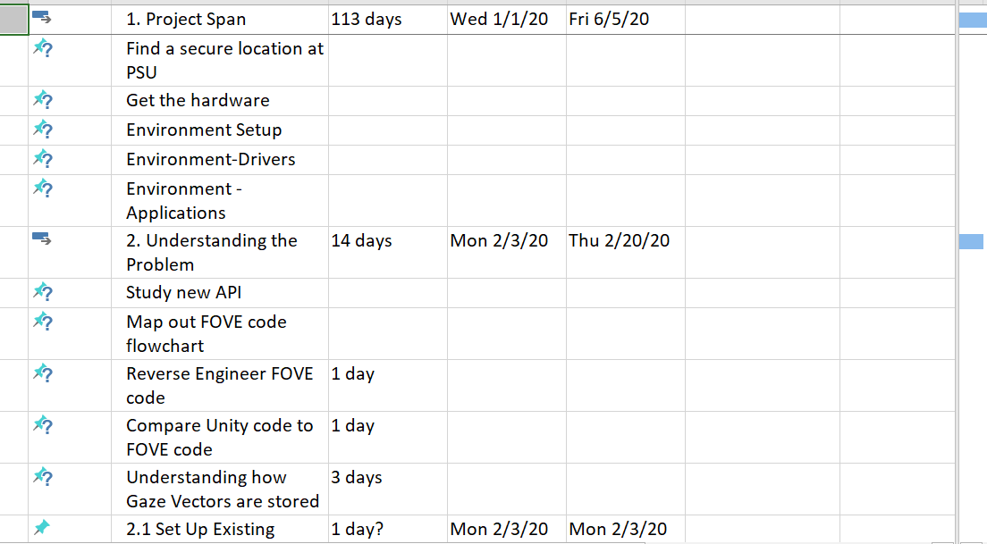
PROJECT SCHEDULE
Click for complete schedule document

Slide 7
TASK LIST
Establish Host Environment
Research/Acquire/Install Drivers
Research/Install dependencies for HW/SW
Leverage FOVE SW and find missing dependencies for HTC Vive Pro Eye
Gaze Camera
Integrate Gaze Calculation from FOVE to HTC Vive Pro Eye
Motion Sensor
Integrate HMD Orientation from FOVE to HTC Vive Pro Eye
Touch Controller
Integrate all dependencies
Modify SW to accommodate

Slide 8
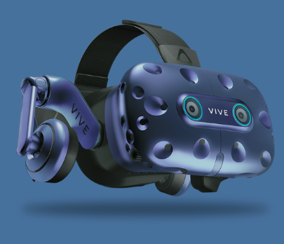
HTC VIVE PRO EYE

Slide 9
TASK LIST OVERVIEW
HW Setup
Modern hardware platform
New headset
New cameras
SW Setup
Research/Obtain API pipeline of gaze vectors
Research/Obtain correction vectors
Find a secure location at PSU
Working touch controller (Wands used in VR)

Slide 10


RESEARCH
SW Dependencies
From FOVE to HTC Vive Pro Eye
HW Dependencies
Connection Changes: needed peripheral connections
Controlling mechanism changes: X-box controller to touch controller
HTC Vive Eye Pro capabilities
Scope - Needed processor power
Speed - Accommodate Bandwidth/Baud Rate

Slide 11

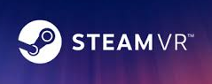
SW DEPENDENCIES
Unity
SteamVR
HTC Vive Pro I API

Slide 12
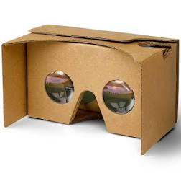
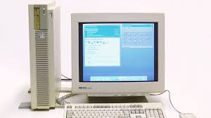
HW DEPENDENCIES
HTC Vive Pro Eye
Strong CPU and GPU for Unity rendering
Touch controller
New Headset
New Cameras

Slide 13
STRETCH GOALS
Correct/Cure strabismus through the use of VR
Incorporate our work with Intel’s neural network to allow automatic plane adjustments to the gaze vector
Integrate touch controller into gaze correction vectors

Slide 14
PROPOSAL
Establish/Build Host Environment
Research/Acquire/Install Environment
Integrate HTC Vive Pro Eye
Install dependencies
Incorporate Gaze calculation/HMD orientation
Successful API pipeline of gaze vectors to correction Vectors
Integrate touch controller for correction vectors
Reduce/Eliminate need for x-box controller
Incorporate/Integrate gaze vectors into correction vectors
Implement SW for holding/distribution of gaze/correction vectors
Establish correction directives for strabismus

